Slide 1
Instructions to Use PPTX Template
First slide should be Paper Title and “Biography” slide
To change the layout of slide, right click slide in left-hand pane and select “layout” and the layouts currently available in the template will display. Select the layout you wish to use. Note: It is not required to use layouts in this template.
To insert the Paper Number, in the menu bar select Insert → Header & Footer. In the “Footer” box, enter the paper number in the indicated format (e.g., XX-###).
Last slide should be “Contact Information” slide
Delete instructions slide once you start creating your PPTX

Slide 2
Validating R for Pharma Streamlining the Validation of Open-Source R Packages within Highly Regulated Pharmaceutical Work
Presented by Anuja Das on behalf of the R Validation Hub
Anuja Das is a Technology Project Specialist within the Data Visualizations and Application Development group at Biogen and a member of the Communications Workstream within the R Validation Hub. She enjoys bringing innovation, automation, and new ways of working to the existing clinical submissions process and has led projects that deploy applications created in multiple languages that enable better data review and output generation.

Slide 3
Agenda
The R Validation Hub
Our White Paper
{riskmetric}
{riskassessment}
Regulatory R Package Repository
Communications
1
2
3
4
5
6

Slide 4


But First…

Slide 5

What is the R Validation Hub?
Some companies are:
Abbvie
Biogen
Lilly
Merck
Parexel
Posit
Roche
Sanofi
And many more…
Nested under the R Consortium
Cross industry collaboration of over fifty biotech and pharmaceutical companies
Initial aim: Consolidate definitions, regulations, and best practices for qualification and validation of the open-source language
Current State: Grown to include a variety of workstreams that produce resources and tools for open-source use aligning with the expectations of regulatory agencies

Slide 6

The White Paper

Slide 7



A Risk-Based Approach for Assessing R Package Accuracy within a Validated Infrastructure
The White Paper
Focuses on systems validation and adequate testing and documentation in keeping with the FDA’s “Statistical Software Clarifying Statement”
Accuracy
Reproducibility
Traceability
“For Intended Use”

Slide 8
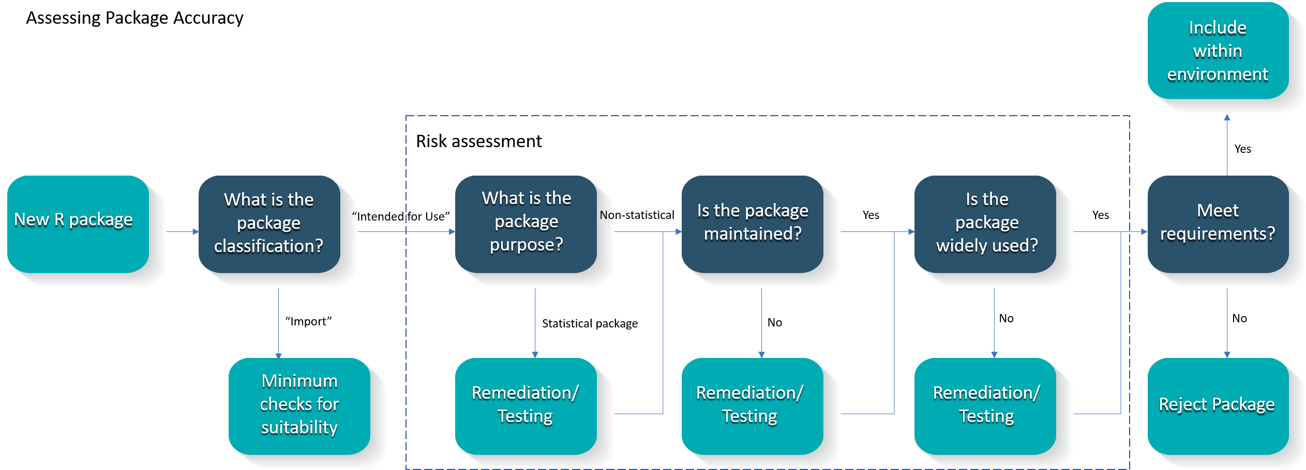
Proposed Risk-Based Approach to Assess Accuracy
The White Paper

Slide 9
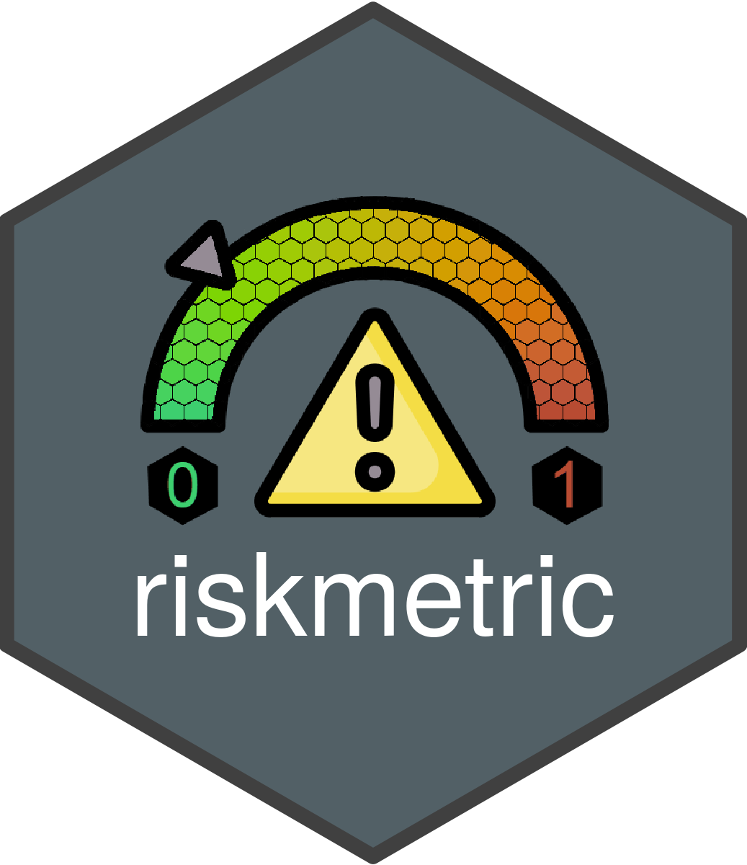
Tool 1: Quantify Risk Programmatically

Slide 10
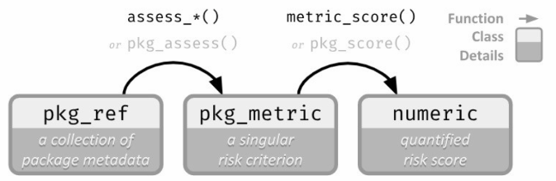
How It Works
{riskmetric}
Perceived Risk
Quantified Risk

Slide 11
How Quality can be Quantified
{riskmetric}
Unit Testing Metrics
A license
Source code available for browsing
An easy to contact maintainer
Up-to-date news regarding new features and bugs
A place to report bugs
Evidence that new bugs are being addressed
Package documentation & user guides/ perhaps a website
Complete Function documentation
Adequate test coverage
Community usage
Many more!
Documentation Metrics
Community Engagement
Maintenance & Reusability

Slide 12
Who can use this
{riskmetric}
Package Developers
Initial testing and subsequent assessment of package complexity and use
Programmers
Determining packages to use in day-to-day work
System Administrator
Understanding additional validation needed

Slide 13
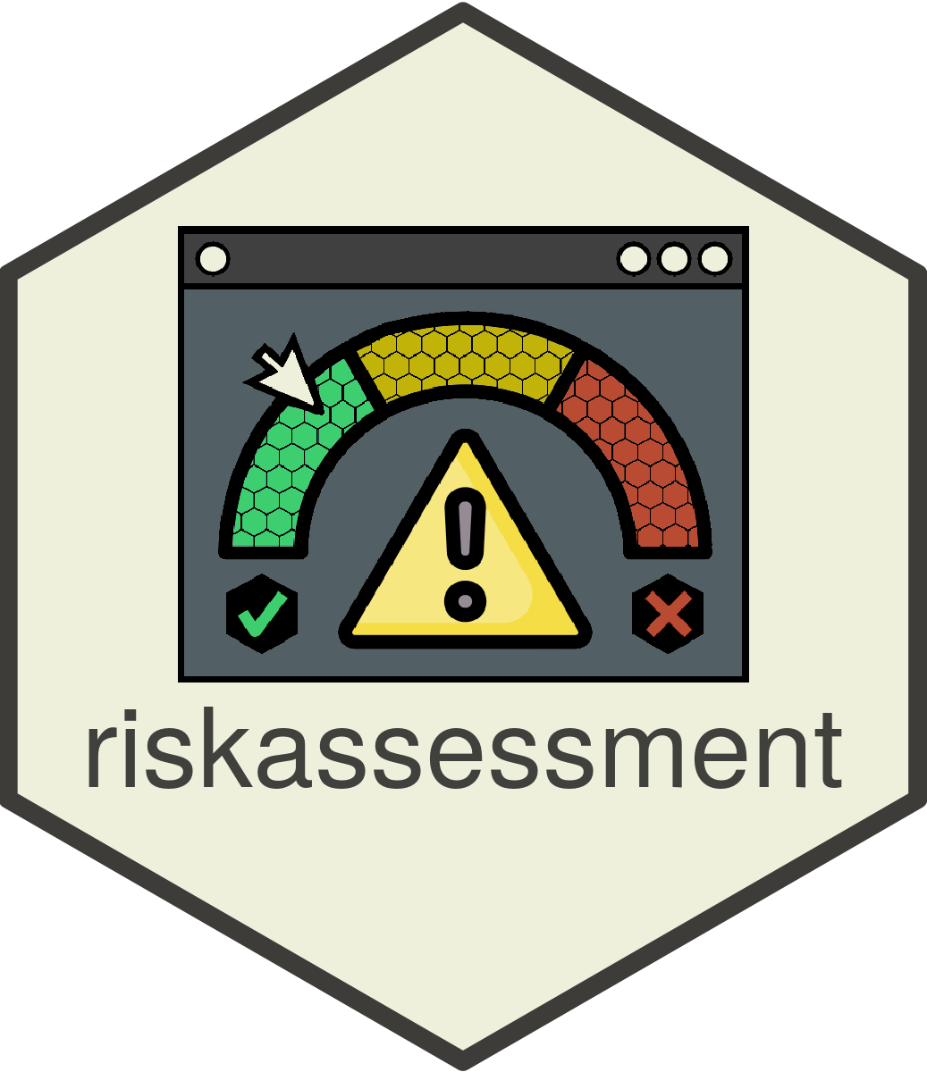

Tool 1: Interactive App using {riskmetric}
Voted ‘Best App’ at Shiny Conference 2023

Slide 14
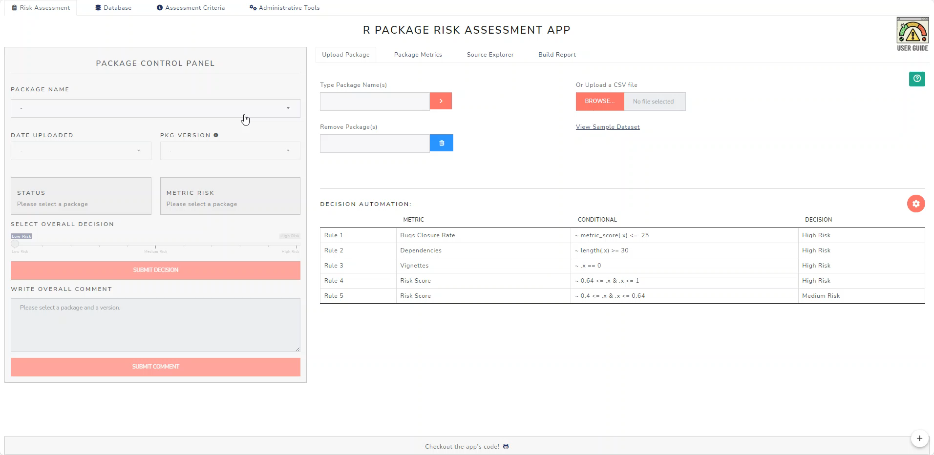
How It Works
{riskassessment}

Slide 15
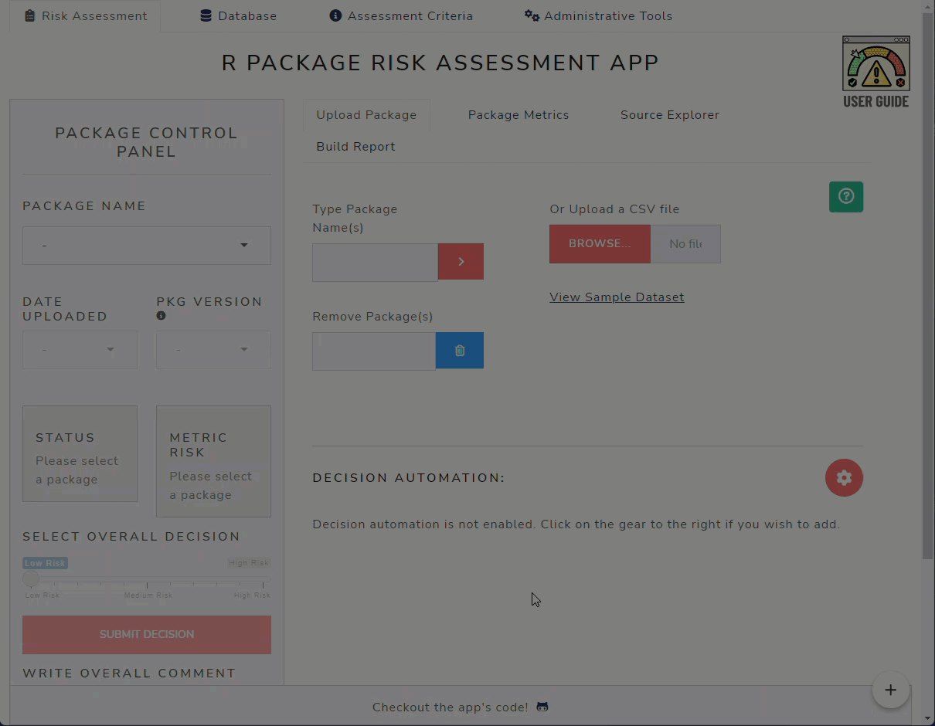
Decision Automation – Integration with {riskassessment}
{riskassessment}

Slide 16
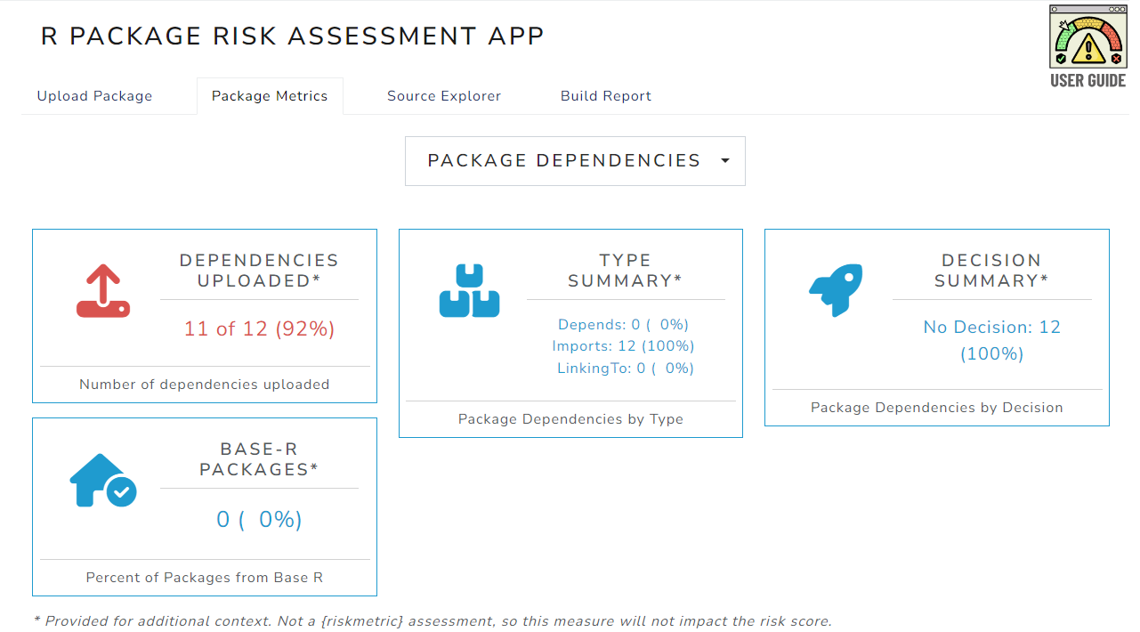
Exploring Dependencies
{riskassessment}

Slide 17

Repositories Workstream

Slide 18

Communications

Slide 19

Our Platforms
Communications
Website (pharmar.org)
Community Meetings
Past topics have included:
Unraveling the term ‘Validation’
A Deep Dive into our tools and resources
Reflecting on industry case studies

Slide 20




Get Involved!!
Communications
The R Validation Hub is always looking to expand their network. These are a few ways to join in.
Be a part of our Working Groups
Join our mailing list and attend Community Meetings
Tell us your ideas
Submit a Case Study

Slide 21
Name: Anuja Das
Organization: Biogen
E-mail: Anuja.das@biogen.com
Web: pharmar.org

